Slide 1
IMF Asset Model Specification Editor
Outline of an editor for authoring and editing the specification part of an asset model, based on the READI Information Modelling Framework
Notes:
Ongoing initiative and task in the READI-JIP project.
Discovered a more generic way/method to build a information model of a plant through FSBs and streams.

Slide 2
Purpose
Provide a minimum of understanding of the asset information modelling framework chosen – as specified by the READI Information Modelling Framework document
Give an outline of desired functionality of an editor for building the specification part of the information model
Outline a step-wise development path of the editor as a software tool
Provide sufficient information to establish a development team and kick off the first step development

Slide 3
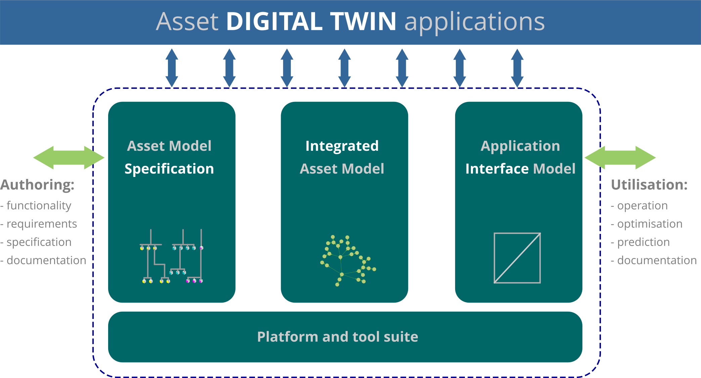
Overview of the Information Modelling Framework
The framework incorporates three core functionalities that integrate to provide complete lifecycle functionality:
Specification
Integration
Utilization
The Specification part is where the asset or facility is designed and specified in a format that can be implemented in the integrated information model
Specification will be done by engineers and domain experts, i.e. Process, Electro, Automation, etc.
Specification will result in descriptive data suitable for Integration – at the simplest XML/AML/JSON
Specification depends on the UX acknowledging legacy engineering user experience and formats
This is the environment of the editor
Sub-modelspecs from Suppliers etc.
Notes:
We are using the language of IEC 81346 to connect aspects
One way of breaking down the facility/plant is to go along with how the engineering process is performed: from early-phase to detail engineering.
Begin with the functional aspect. That’s where the focus is now
Start with Process Block Diagrams –> Flow diagrams –> Schematics –> P&IDs
The connection to existing diagrams/drawings

Slide 4
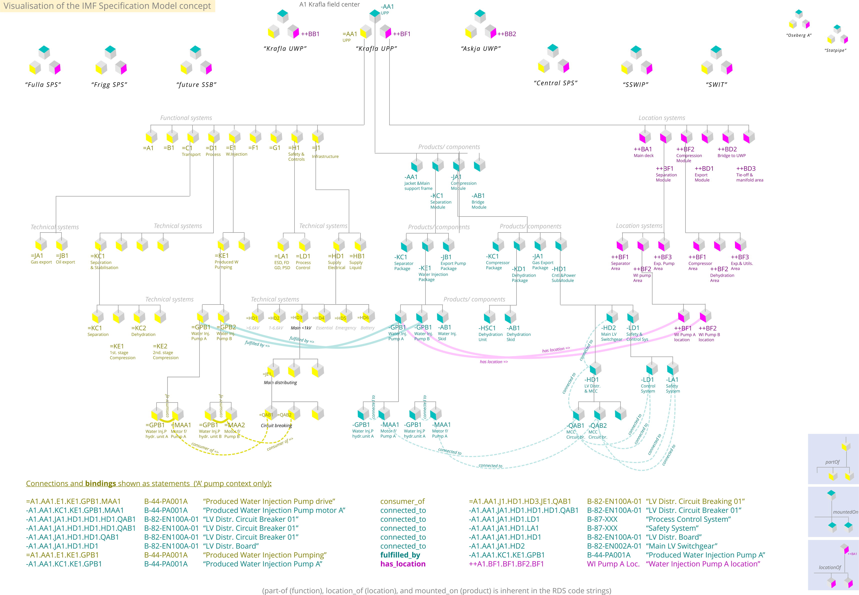
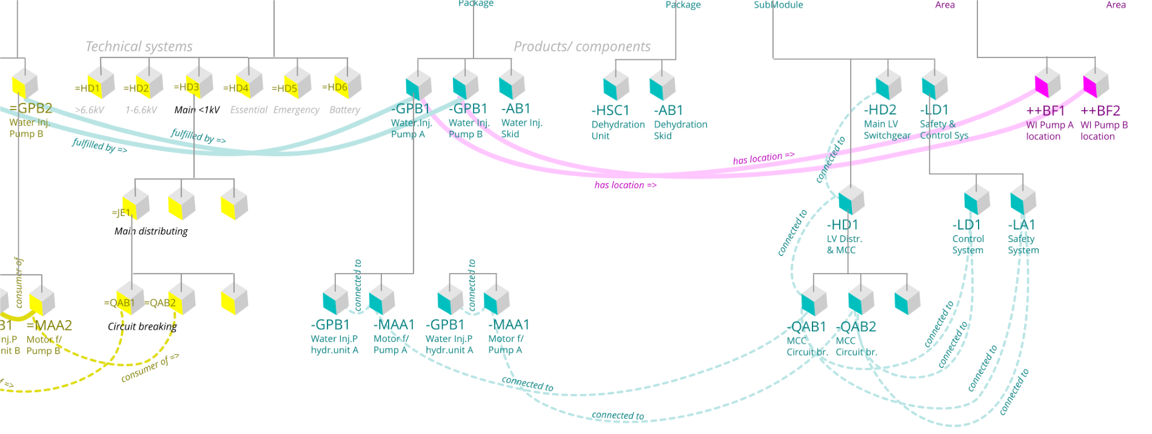
The model Specification is based on ISO/IEC 81346
The picture illustrates the hierarchy, topology, classification, and parameterisation contained in an asset model specification.
Identifiers for each object is comprised of the complete RDS path beginning at the root node
ID's are separate for each aspect (Functional, Product, Location, InstalledAs, etc.)
Objects are Function System Blocks – shown as cubes, and Streams – shown as dotted lines.
Every object is assigned attributes such as Category, Type/Class, and varying ranges of parameters

Slide 5
Editor – two work surfaces, one data set
For working on the hierarchy of objects, a tree-based format is better fit for purpose.
This should resemble legacy Systems Engineering UX.
For working on the flow or stream between functions, a block schematics format is better fit for purpose.
This should resemble legacy Process block diagram UX.
Each level in the hierarchy is shown in one surface of diagrams

Slide 6
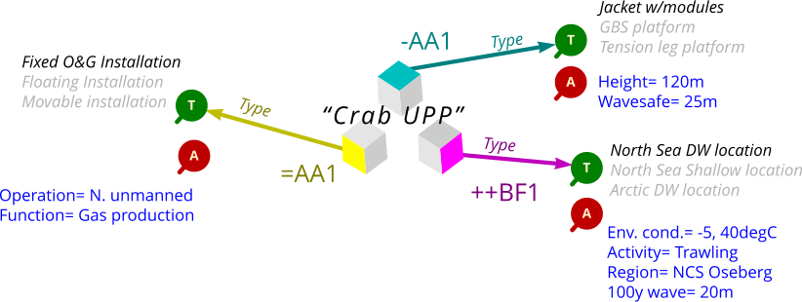
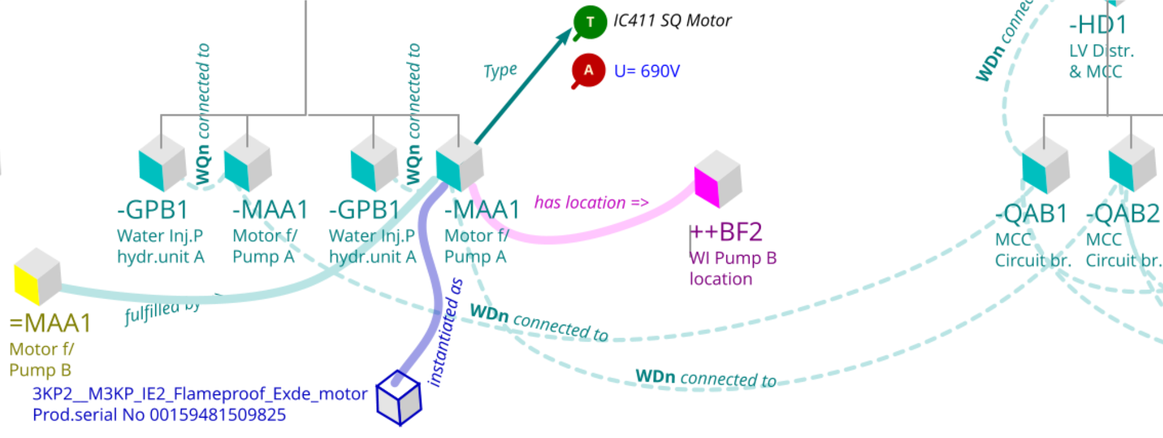
Specification object parameters
Every specification object (cube) has several parameters, selected or provided by the user
'Category' is selected from the coding defined by industry standard reference designation (e.g. =AA1)
'Type' is selected from industry standard classes (e.g. Centrifugal Pump)
The range and definition of 'Attributes' is given by the selected 'Type' (e.g. Pressure, Flow, Temp.)
The values of 'Attributes' is provided by the user (e.g. 160 bar, 200m3/h, 45degC)
Every specification object has several relations within a specific aspect (e.g. connected to), as well as between specific aspects (e.g. fulfilled by)
Yellow: Functional aspect
Cyan: Physical aspect
Mangenta: Location aspect
Blue: Installed as aspect

Slide 7
Data resulting from creating a basic model specification
{
"Node0": {
"ParentRDSpath": "No parent",
"ParentRDS": "",
"NodeLevel": "0",
"NodeRDS": "CRAB",
"NodeDescription": "Unmanned Process Platform",
"NodeVariant": "RootFacility",
"NodeStatus": "undef",
"NodeType": "Fixed installation",
"NodeBindsTo": "unbound",
"nAttributes": "3",
"Attributes": [
{
"Data": {
"Name": "TAG",
"UOM": "WD",
"Value": "Weight"
}
},
{
"Data": {
"Name": "",
"UOM": "m",
"Value": "tonne"
}
},
{
"Data": {
"Name": "Crab UPP",
"UOM": "200",
"Value": "34000"
}
}
]
},
"Node1": {
"ParentRDSpath": "CRAB",
"ParentRDS": "CRAB",
"NodeLevel": "1",
"NodeRDS": "=WP1",
"NodeDescription": "Reservoir HC",
"NodeVariant": "Input_materials",
"NodeStatus": "bound_inAspect",
Data shown here is XML from a test case. JSON would be equally suitable, but probably a more developed structure will be needed in order to capture the full range of parameters, even for a basic standalone editor.
For an editor version that integrates with shared resources such a RDS codes, class libraries, and other libraries, a more sophisticated structure is likely needed.
For an editor version that tightly integrates with the Integrated Asset Model, entirely different mechanisms and formats could be needed, e.g. EDA and OWL2.
JSON
or
XML
or
AML
JSON
JSON-LD

Slide 8
Step-wise approach -to prototype editor functionality
Full Editor
Cloud-based, multi-user, integrated with shared libraries as well as seamlessly integrates with Integrated Asset Model
Industry Editor
Cloud-based, multi-user, integrated with shared lib's.
Produces verified JSON-LD files that can be batch transformed into Integrated Asset Model.
Engineers at large
Basic Editor
Cloud-based, multi-user, stand-alone with no integration of shared lib's.
Produces JSON files that can be batch transformed into Integrated Asset Model.
Engineers with basic IMF training
Engineers skilled in IMF model specification
Editors/ functionality for Process Discipline
Editors/ FUNCTIONALITY for Automation Discipline
Editors/ functionality for Electro Discipline

